Slide 1
Y11 Transition to Y12 Health and Social Care Extended Diploma (Triple)
Unit 3 – Anatomy and Physiology
Pre-learning

Slide 2
Specification / Context
You can find the specification for the course at: https://qualifications.pearson.com/en/qualifications/btec-nationals/health-and-social-care-2016.html
Make sure that you select the correct course from the specification drop down box before selecting download:
Find the unit information within the specification for Unit 3 Anatomy and Physiology
Read through this so that you are familiar about the content of the unit and how you will be assessed. We will go through this thoroughly at the beginning of the course.

Slide 3
About the unit
This is a 1 ½ hour written examination, which you will sit in January 2025.
You are allowed to have 3 attempts at the examination. Examinations can be sat in January or in June.
The unit is 120 Guided Learning Hours.
You will learn about the structure and organisation of the human body including cells, tissues and organs, energy and genetics. You will learn in detail the structure and function of 10 body systems and disorders that are associated with each. Finally you will learn about medical research including clinical trials, epidemiological studies and data/statistics.

Slide 4
Cells and Organelles
Use this website link to recap cells and organelles. You will have looked at these in biology at GCSE. If you register you can do the tests too.
https://www.s-cool.co.uk/a-level/biology
We are only concerned with human (animal)cells so ignore the information on plants .. unless you are interested!

Slide 5
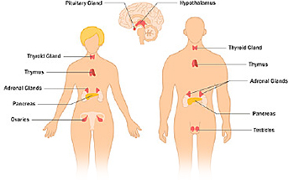
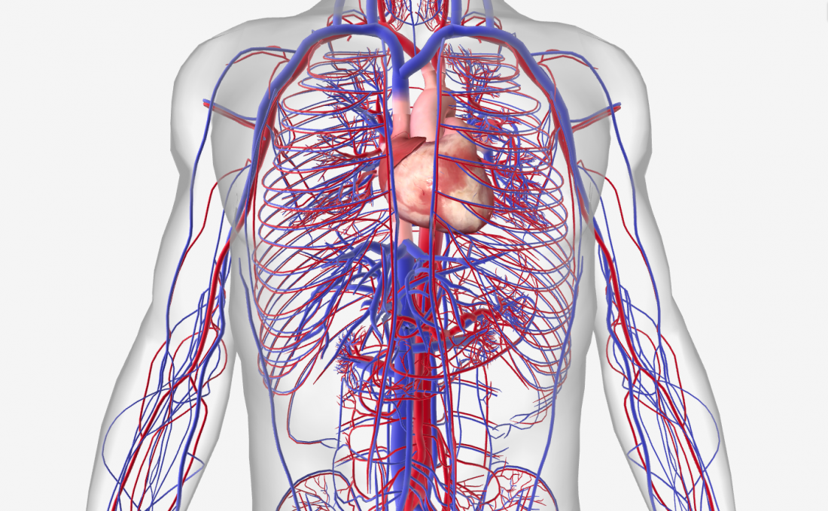
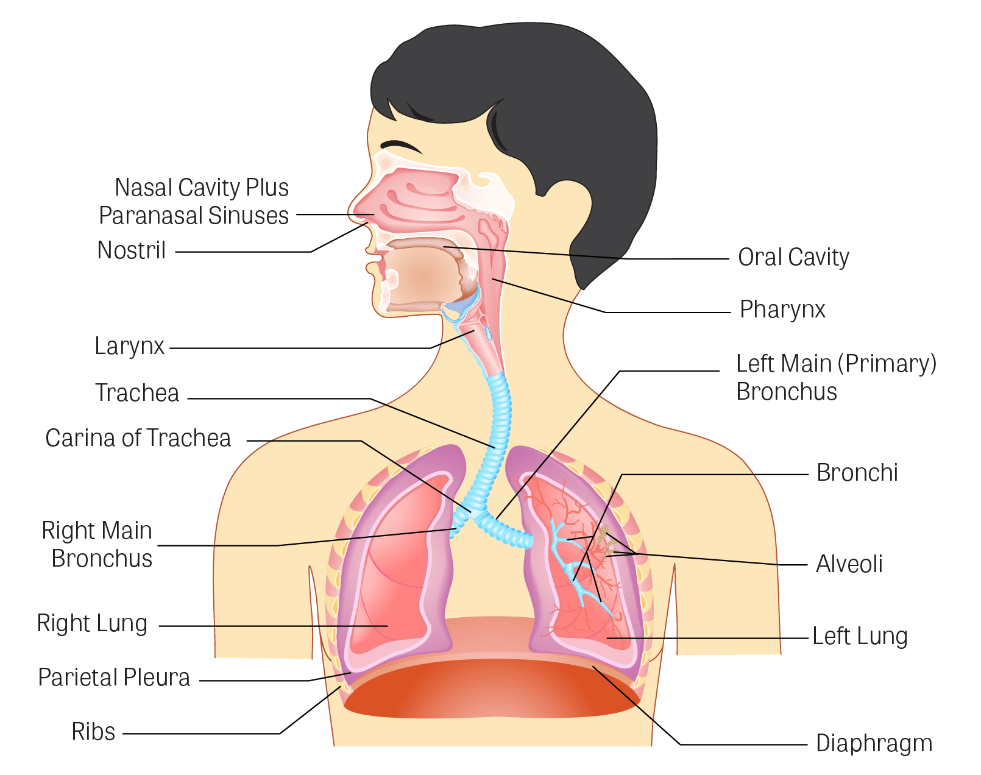
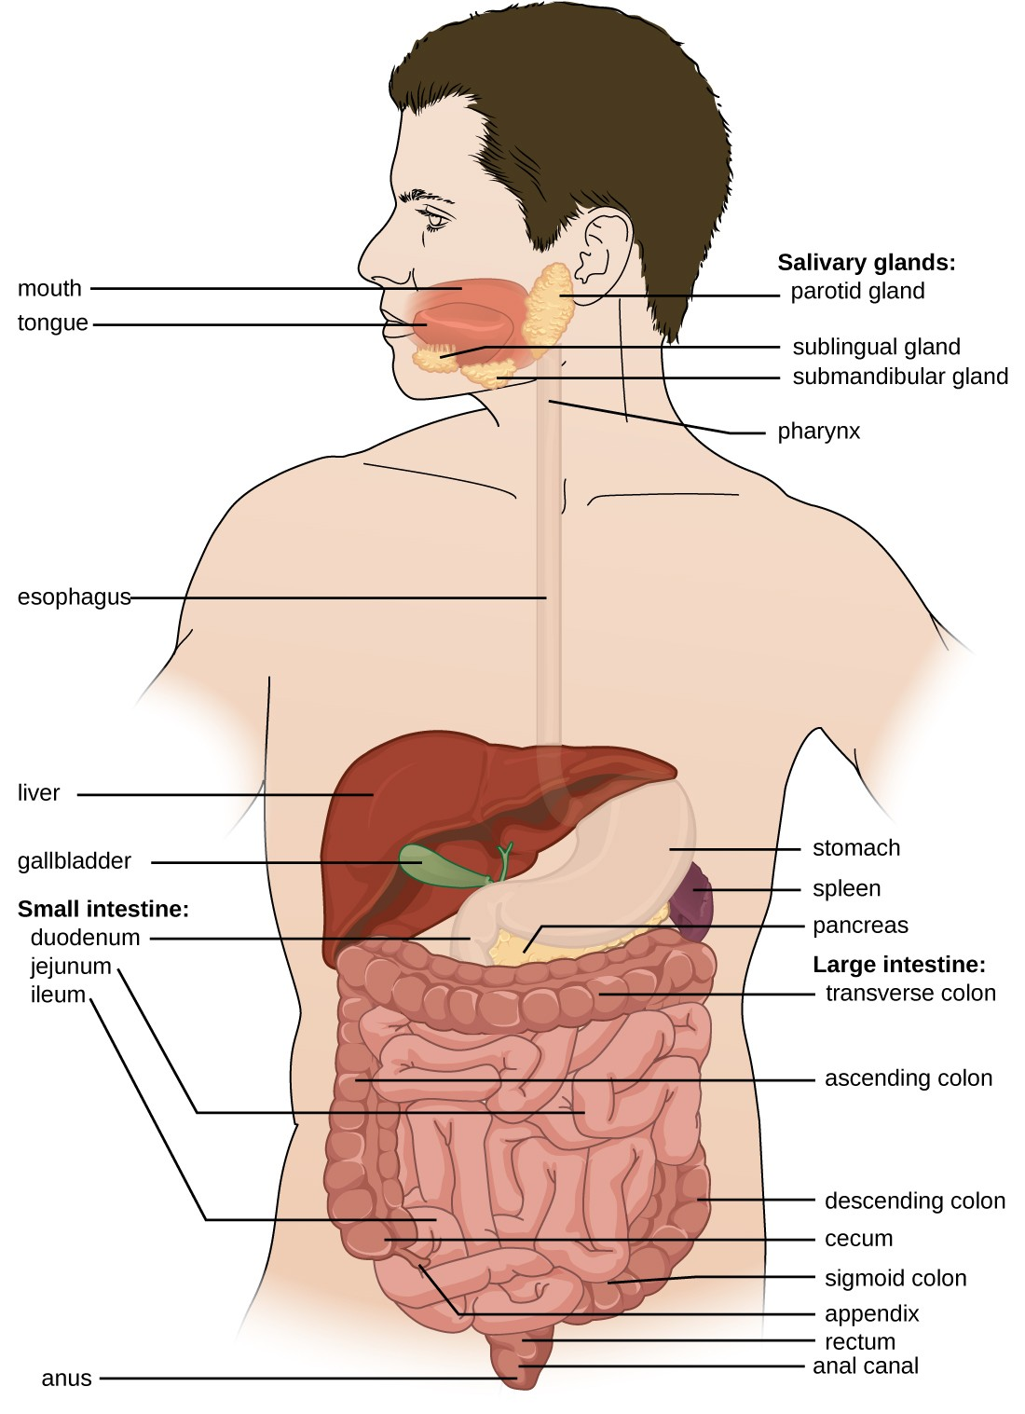
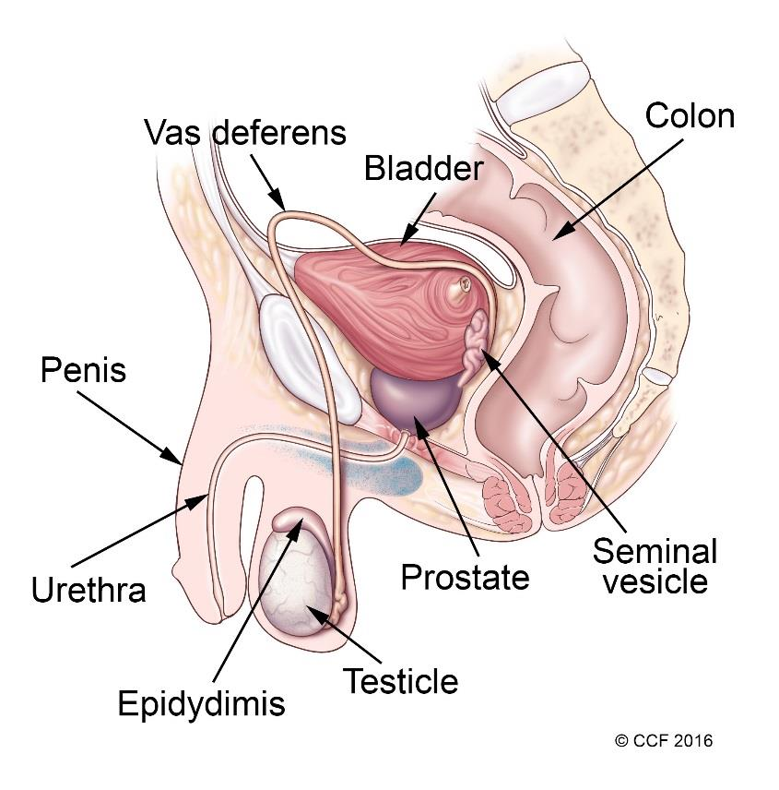
Body Systems
How many body systems can you name?

Slide 6
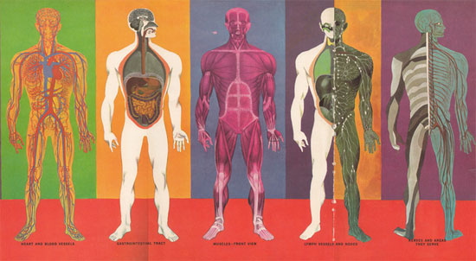
Build a body
Get some BIG paper or stick about 10 sheets of A4 together.
Either ask someone to draw around the outline of your body of sketch a body.
Add to your picture (researching if needed) the following organs:
Liver / Stomach / Heart / Lungs / Colon / Kidneys / Bladder / Ovaries or Testes / Pancreas / Brain / Duodenum / Ileum / Uterus / Skin
Do you know any keywords associated with each organ? Write them nearby.

Slide 7
Disorders
Disorders (Choose at least 2):
Diabetes Insipidus
Hodgkin’s Disease
Hydrocele
Coeliac Disease
Hepatitis
Muscular Dystrophy
Parkinson’s Disease
Dementia
Endometriosis
Pneumonia
Stroke
From the list in the box, research at least 2 disorders.
In your research notes, include:
Which body system and organs does the disorder effect?
What causes the disorder
What symptoms and complications are associated with it?
How is it treated?

Slide 8
Reading List
Books:
BTEC National Health and Social Care Student Book 1: For the 2016 specifications
Ross & Wilson Anatomy and Physiology in Health and Illness by Grant & Waugh
Websites:
https://www.youtube.com/playlist?list=PL8dPuuaLjXtOAKed_MxxWBNaPno5h3Zs8
https://opentextbc.ca/anatomyandphysiology/chapter/1-1-overview-of-anatomy-and-physiology-2/
https://www.s-cool.co.uk/a-level/biology

